Slide 1

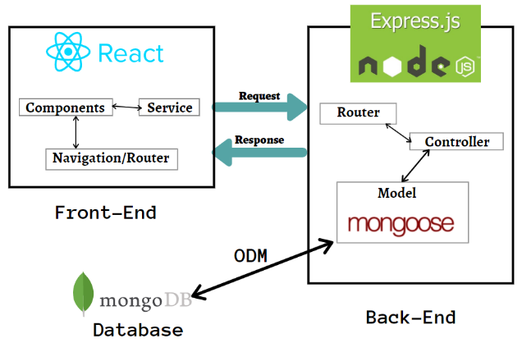
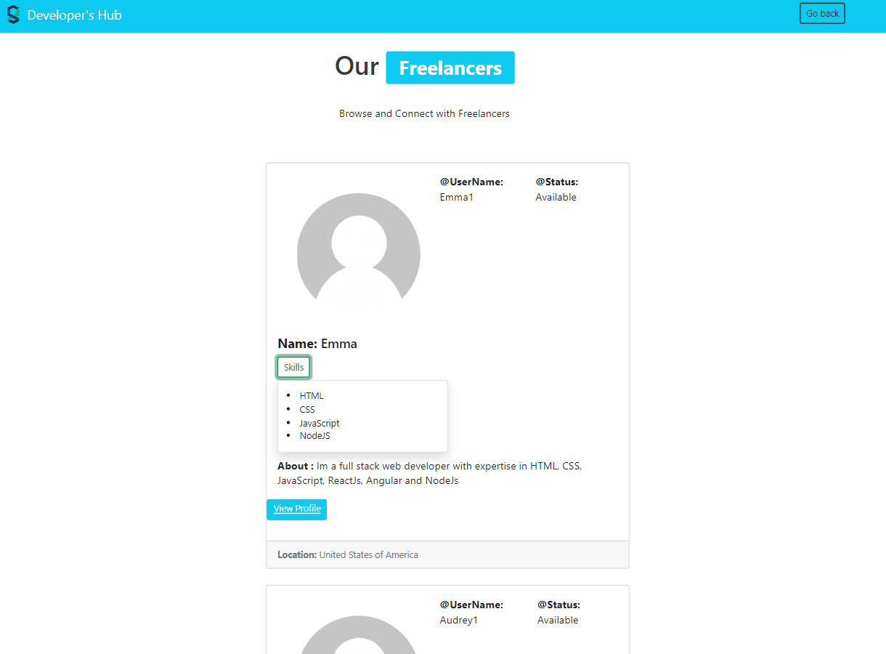
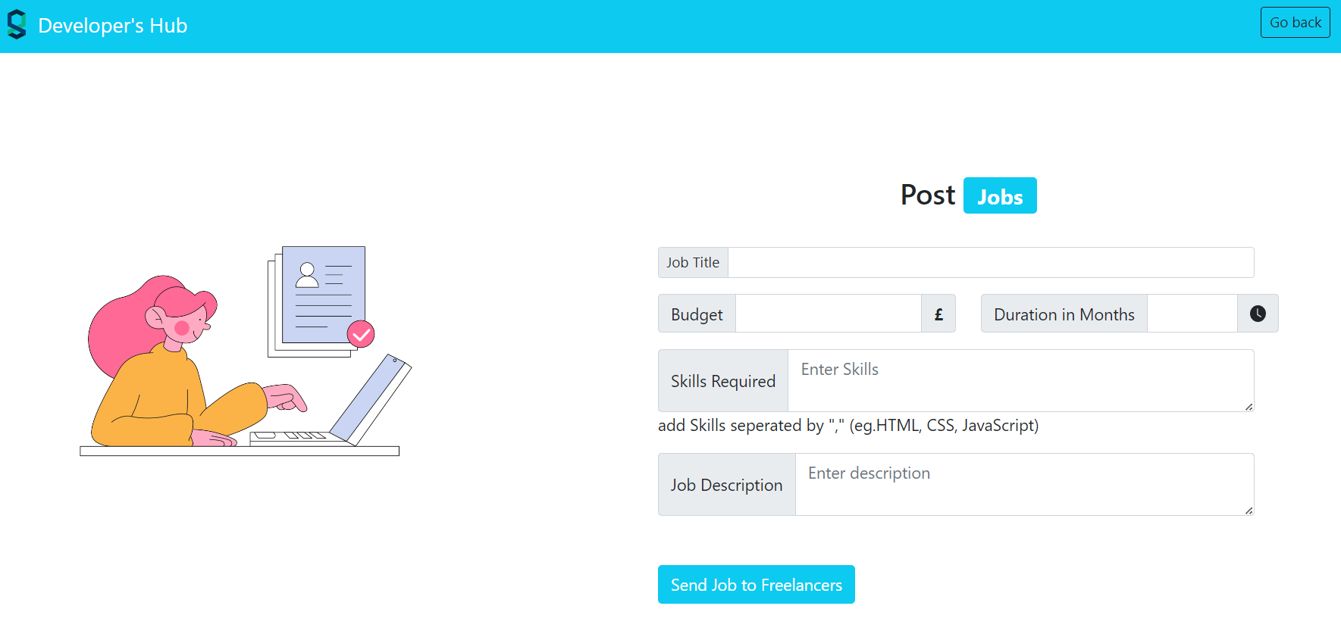
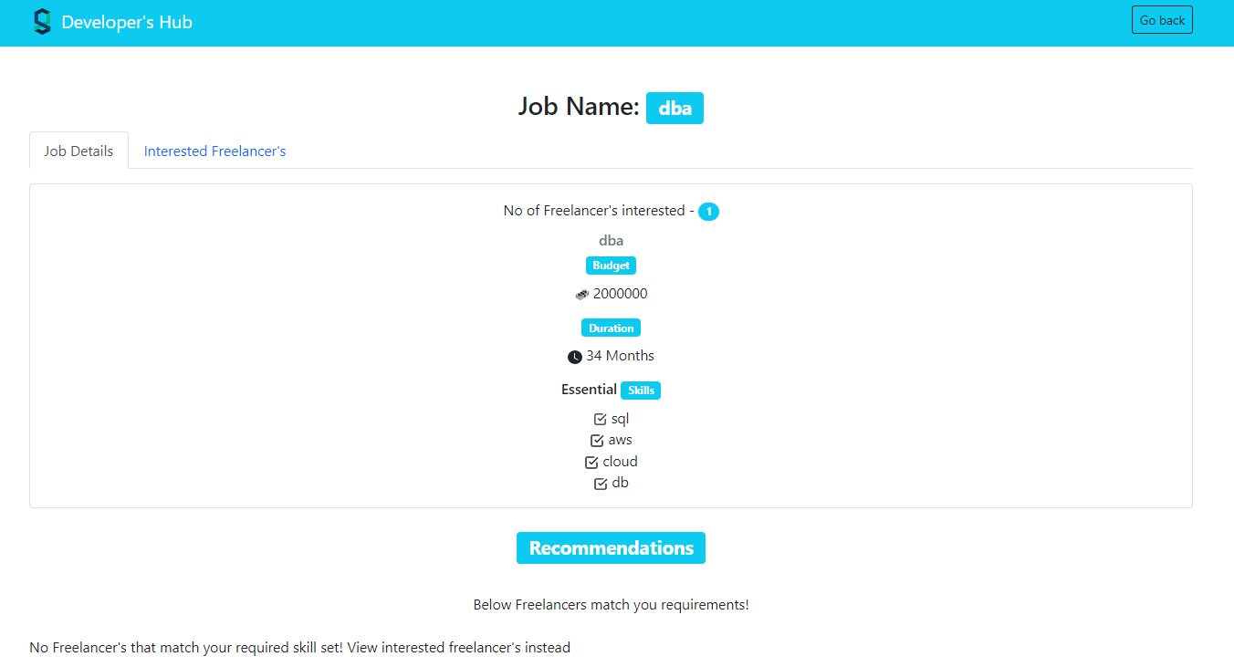
Developers’ Hub – Job Recommendation Portal
Krunal Savaj AU1940271
Introduction
Analysis
Conclusions
Introducing “Developers’ Hub“ a cutting-edge platform that parallels Fiverr and Upwork, connecting two pivotal users: freelancers/students and business organizations. Developers’ Hub empowers freelancers/students by providing an avenue to showcase their skills and find rewarding projects. Simultaneously, it offers businesses a streamlined process to access a diverse talent pool, ensuring efficient collaborations, fostering Growth and mutual success.
There are several products available on the market that enable freelancer employees to find and offer their services online. Examples of such application are UpWork, Fiverr, and Freelancers. The bid process that each freelancer must go through in order to win the job is a worry with this application, and these apps encourage team registrations.
Unique Features in the application
• No teams may register, and no freelancers may submit bids for projects.
• The project's budget, duration, and other details are decided by business.
• Giving students the chance to work as freelancers and get experience on a genuine project.
• Creating a recommendation system to assist organizations in finding independent Freelancers whose skill sets are a perfect match.
In conclusion, our project aims to address the growing demand for efficient and reliable connections between freelancers/students and business organizations. We provide a cutting-edge platform that streamlines the process of finding the right talent for the job. Our user-friendly interface and diverse talent pool ensure that both freelancers/students and businesses can find success through Developers’ Hub.
In the application Content based filtering has been set by which business organization can get exact right choice in freelancers.
In future Database will be shifted to MS SQL Server to get the scalability and efficient performance in the application.
Methodology
S
:
Results
This page shows All freelancer present on the portal.
One freelancer can see other freelancers so that they can get the current market technology Stack
References
React-Bootstrap. react.
React.
Redux - a predictable state container for JavaScript apps
Node.js and Express.js
NPM
Collaborative filtering vs content-based filtering for Recommender Systems. Analytics India Magazine
Software development Model: Scrum
System Architecture: Monolithic architecture
Frontend: The user interface is created, views are handled, and components are managed using React.js.
Backend: Express.js and Node.js are used to build server-side functionality, manage API routes, and communicate with databases.
Database: For storing and retrieving data, MongoDB is used as a NoSQL database.
Redux: Redux is a state management tool that enables centralized, predictable data flow throughout the application.
This stack offers solution that makes use of Redux for state management while facilitating effective development between the frontend and backend components.
This functionality enables business organizations to post jobs with specific details.
Freelancer will be able to see the posted jobs from their portal.
Contributions
I was responsible for the design phase, front-end development as well as backend development, and Database integration. I encountered various bugs and data retrieval errors and difficulties along the way, as I had anticipated.
I was able to get through these problems with the help of my mentor. My mentors constantly helped me to understand the market in depth.
This functionality enables business organizations to see their own Posted job.
There is a separate card in which organization can see the interested freelancers.

